Slide 1


1- click Infrastructure Automation

Slide 2


Details
Name | DT Number | Email-Id | College | Phone
M Mani Shanker | DT20184437359 | shanker0238@gmail.com | CMR College of Engineering and Technology | +91-9059609410
Presentation: https://youtu.be/lFMh_9VZV3o
Source code: https://github.com/shanker0238/Shanker_Autonomous_Infrastructure.git

Slide 3
Problem statement
Autonomous Infrastructure is designed to automate the Infrastructure Life-Cycle management from build to decommission.
It leverages Machine Learning functionality which helps to assimilate the information that it needs to take care it of self. It monitors the overall utilization of the ecosystem in various aspects i.e. CPU, Memory, Disk, Network and create the pattern of utilization.
Based on trend it will recommend and automate the sizing of the infrastructure in an effort to avoid performance problems.

Slide 4
Technologies Used
Amazon Web Services
Elastic Cloud Compute – EC2
Linux - Ubuntu
Terraform
Auto-Scaling
Elastic Load Balancer
Cloud Watch

Slide 5
Breakup of Problem Statement -1
Statement 1:
Autonomous Infrastructure is designed to automate the Infrastructure Life-Cycle management from build to decommission.

Slide 6
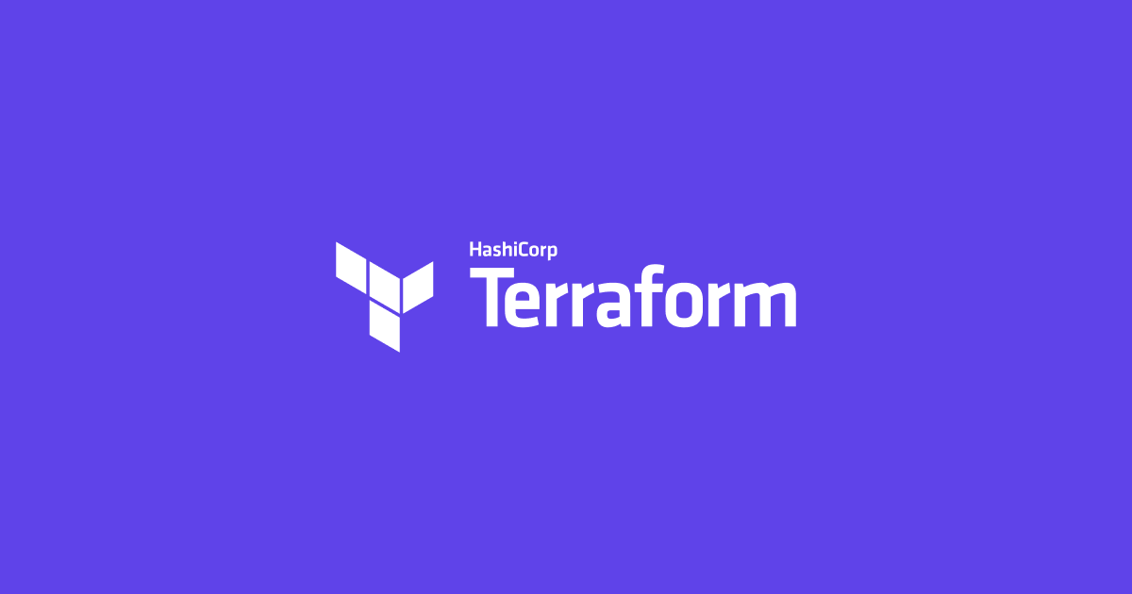
Statement 1 - solution
Terraform is a tool for building, changing, and versioning infrastructure safely and efficiently. Terraform can manage existing and popular service providers as well as custom in-house solutions.
How we are using ?
Building Infrastructure As A Code ( IAC ) to make it a single clickable solution.

Slide 7
Breakup of Problem Statement -2
It leverages Machine Learning functionality which helps to assimilate the information that it needs to take care it of self. It monitors the overall utilization of the ecosystem in various aspects i.e. CPU, Memory, Disk, Network and create the pattern of utilization.

Slide 8

Statement 2 - solution
Amazon CloudWatch is a monitoring and observability service .
CloudWatch provides you with data and actionable insights to monitor your applications, respond to system-wide performance changes, optimize resource utilization
CloudWatch collects monitoring and operational data in the form of logs, metrics, and events, providing you with a unified view.
Another solution for on-prem infra will be Grafana
How we are using ?
CloudWatch monitors our infra and it will trigger an alarm event based on the condition set.

Slide 9
Breakup of Problem Statement - 3
Based on trend it will recommend and automate the sizing of the infrastructure in an effort to avoid performance problems.

Slide 10


Statement 3 - solution
AWS Auto Scaling monitors your applications and automatically adjusts capacity to maintain steady, predictable performance at the lowest possible cost.
Elastic Load Balancing automatically distributes incoming application traffic across multiple targets, such as Amazon EC2 instances, containers, IP addresses, Lambda functions, and virtual appliances.
How we are using ?
Infrastructure will be scaled up when there is a high load on the servers and scale down when load goes down.
In ELB, the policy will be written based on the application availability through health checks.
In Auto scaling , the policy is written based on the CPU, Memory and Disk utilization. If threshold is breached for the items, the infra will scale accordingly.

Slide 11
Code Explanation
Source code: https://github.com/shanker0238/Shanker_Autonomous_Infrastructure.git

Slide 12
How to run the code ?

Slide 13
System requirements
System requirements:
Ubuntu Server with 20.04/18.04/16.04 LTS
2 CPU and 4 GB RAM

Slide 14
Terraform installation
Installation commands:
sudo apt update
sudo apt-get install wget unzip -y
sudo wget https://releases.hashicorp.com/terraform/0.12.26/terraform_0.12.26_linux_amd64.zip
sudo unzip terraform_0.12.26_linux_amd64.zip
sudo mv terraform /usr/local/bin/
terraform -v

Slide 15
Cloning and changes
Clone the code from github
Git clone https://github.com/shanker0238/Shanker_Autonomous_Infrastructure.git
Navigate to tcs_auto_infra.tf
Add your Access key, secret key and key pair information to the code in designated sections mentioned in the code.

Slide 16
Code Execution
Navigate to the local working copy of the repository cloned.
Perform below commands
Terraform init – Initializes and downloads the required modules mentioned in our terraform script.
Terraform plan – Gives you the info of what are the resources that gets created before we proceed to apply
Terraform apply – Create all the resouces mentioned and store the state of the resources in terraform state file that created.
Navigate to AWS console and check for the creation of all the resources automatically.
For decommissioning of the infrastructure created. Perform the below step.
Terraform destroy – Delete all the infrastructure created

Slide 17
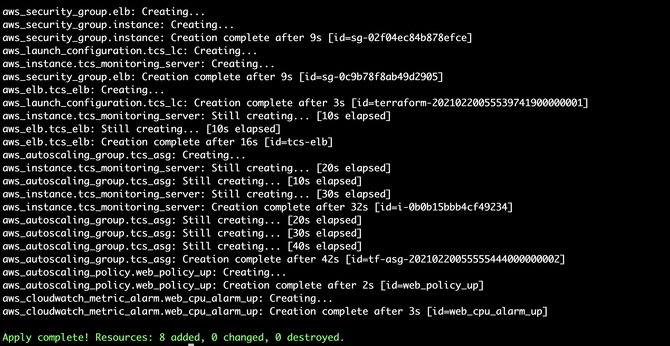
Results with evidence screenshots
Following resources are created from script

Slide 18
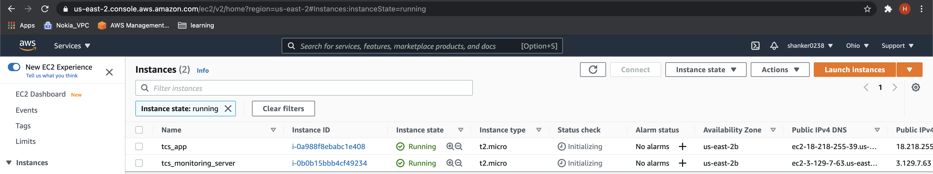
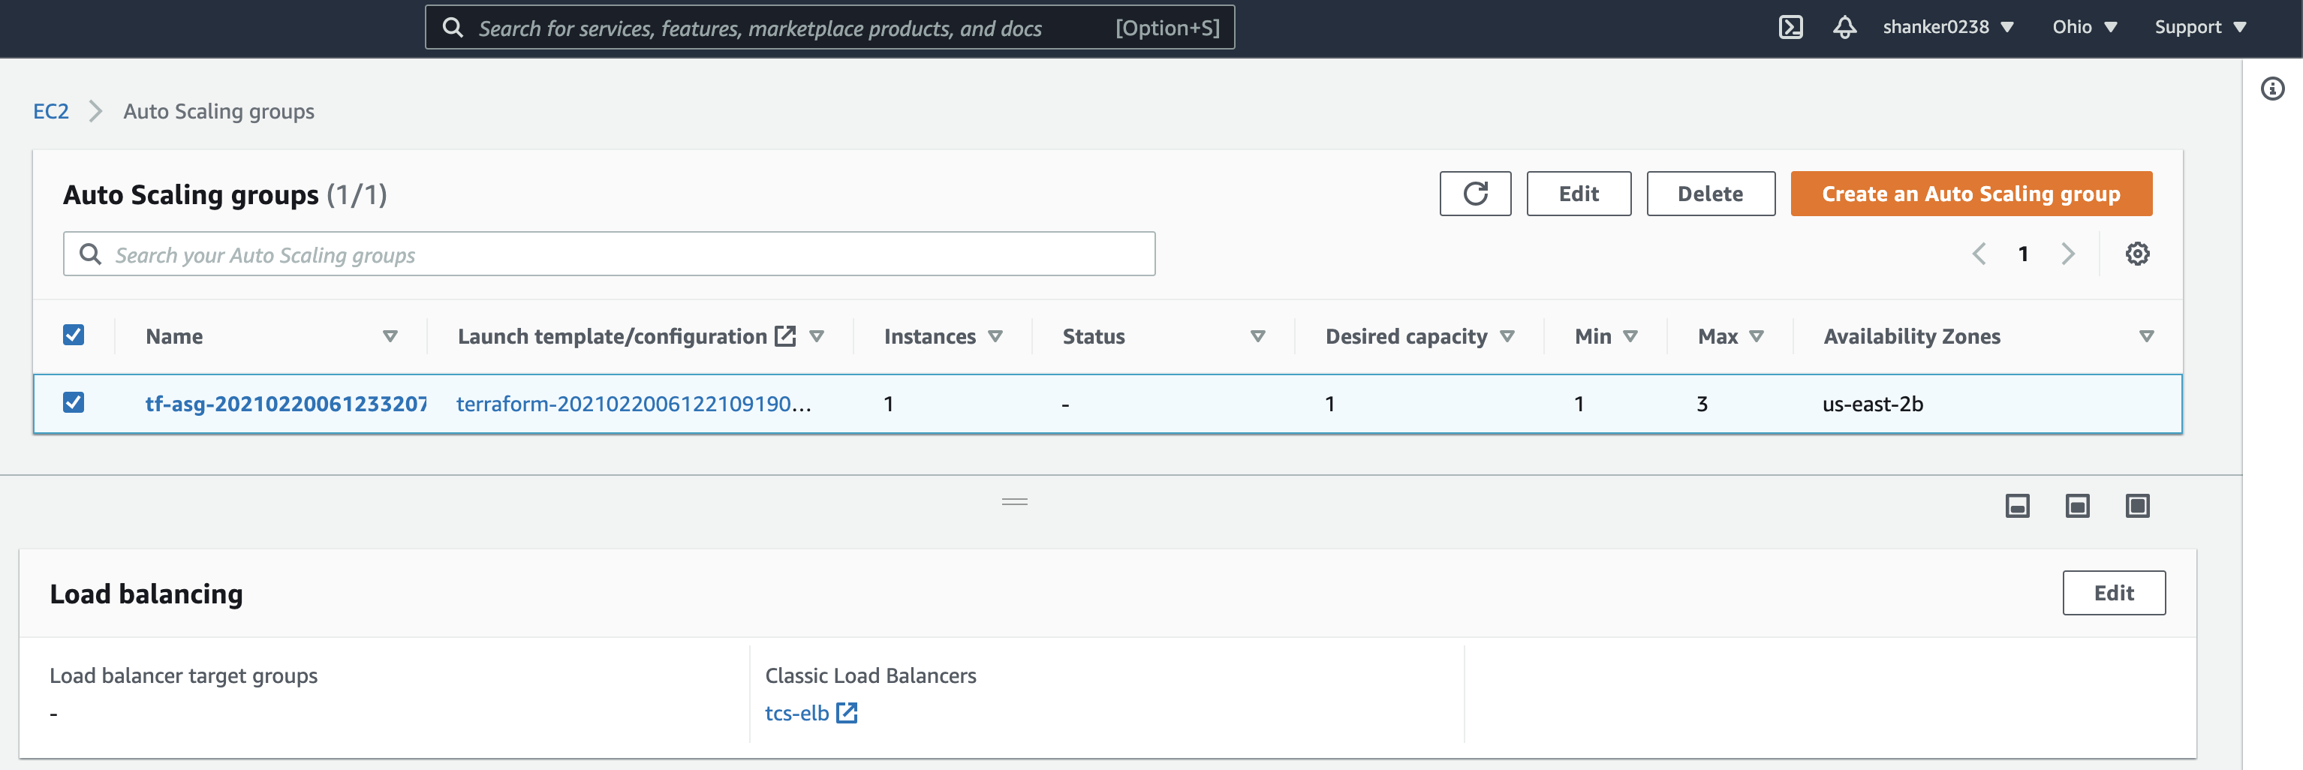
Instances created
Autoscaling Group with Load balanced attached

Slide 19
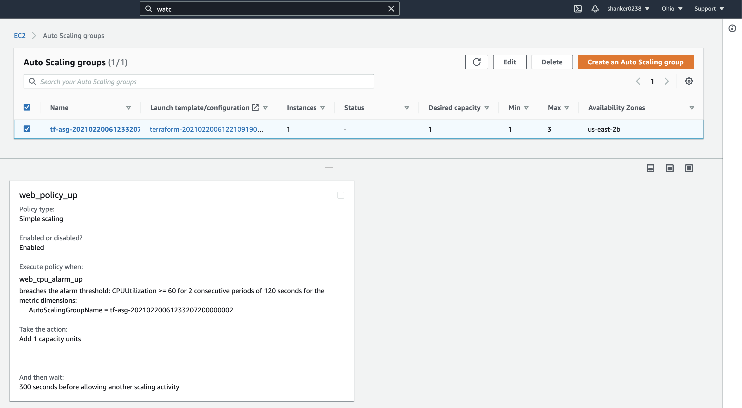
Autoscaling group created with attached scaling policy

Slide 20
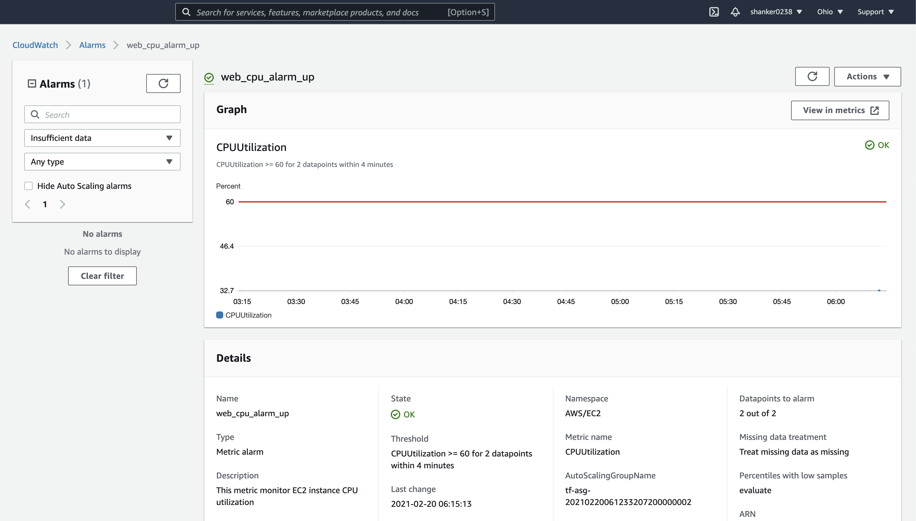
Cloud watch alarm created and threshold set

Slide 21
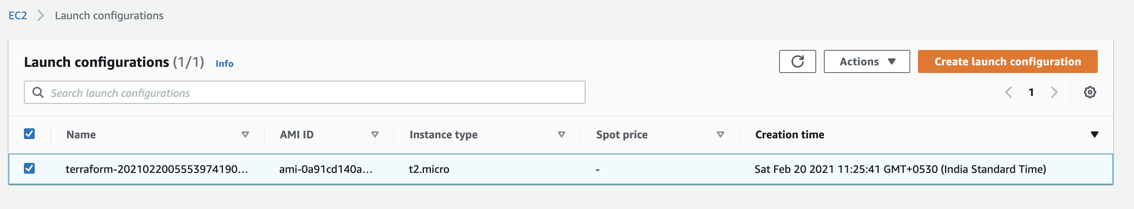
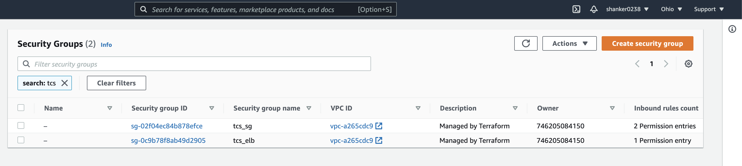
Launch Configuration created
Security Groups created

Slide 22
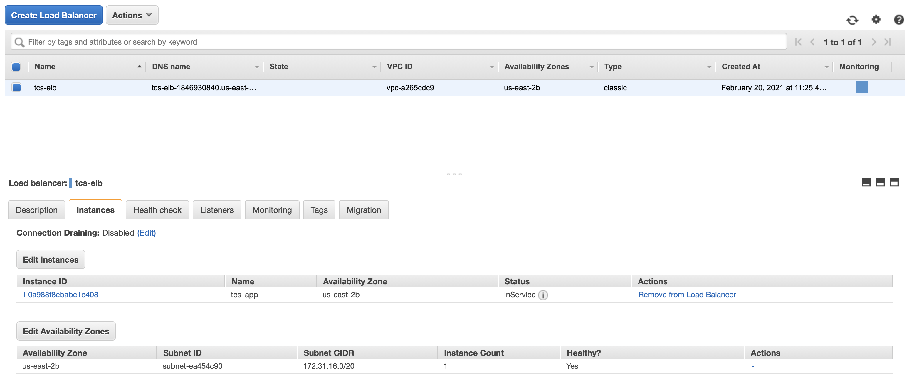
Elastic Load Balancer Created and instance attached to Autoscaling group

Slide 23
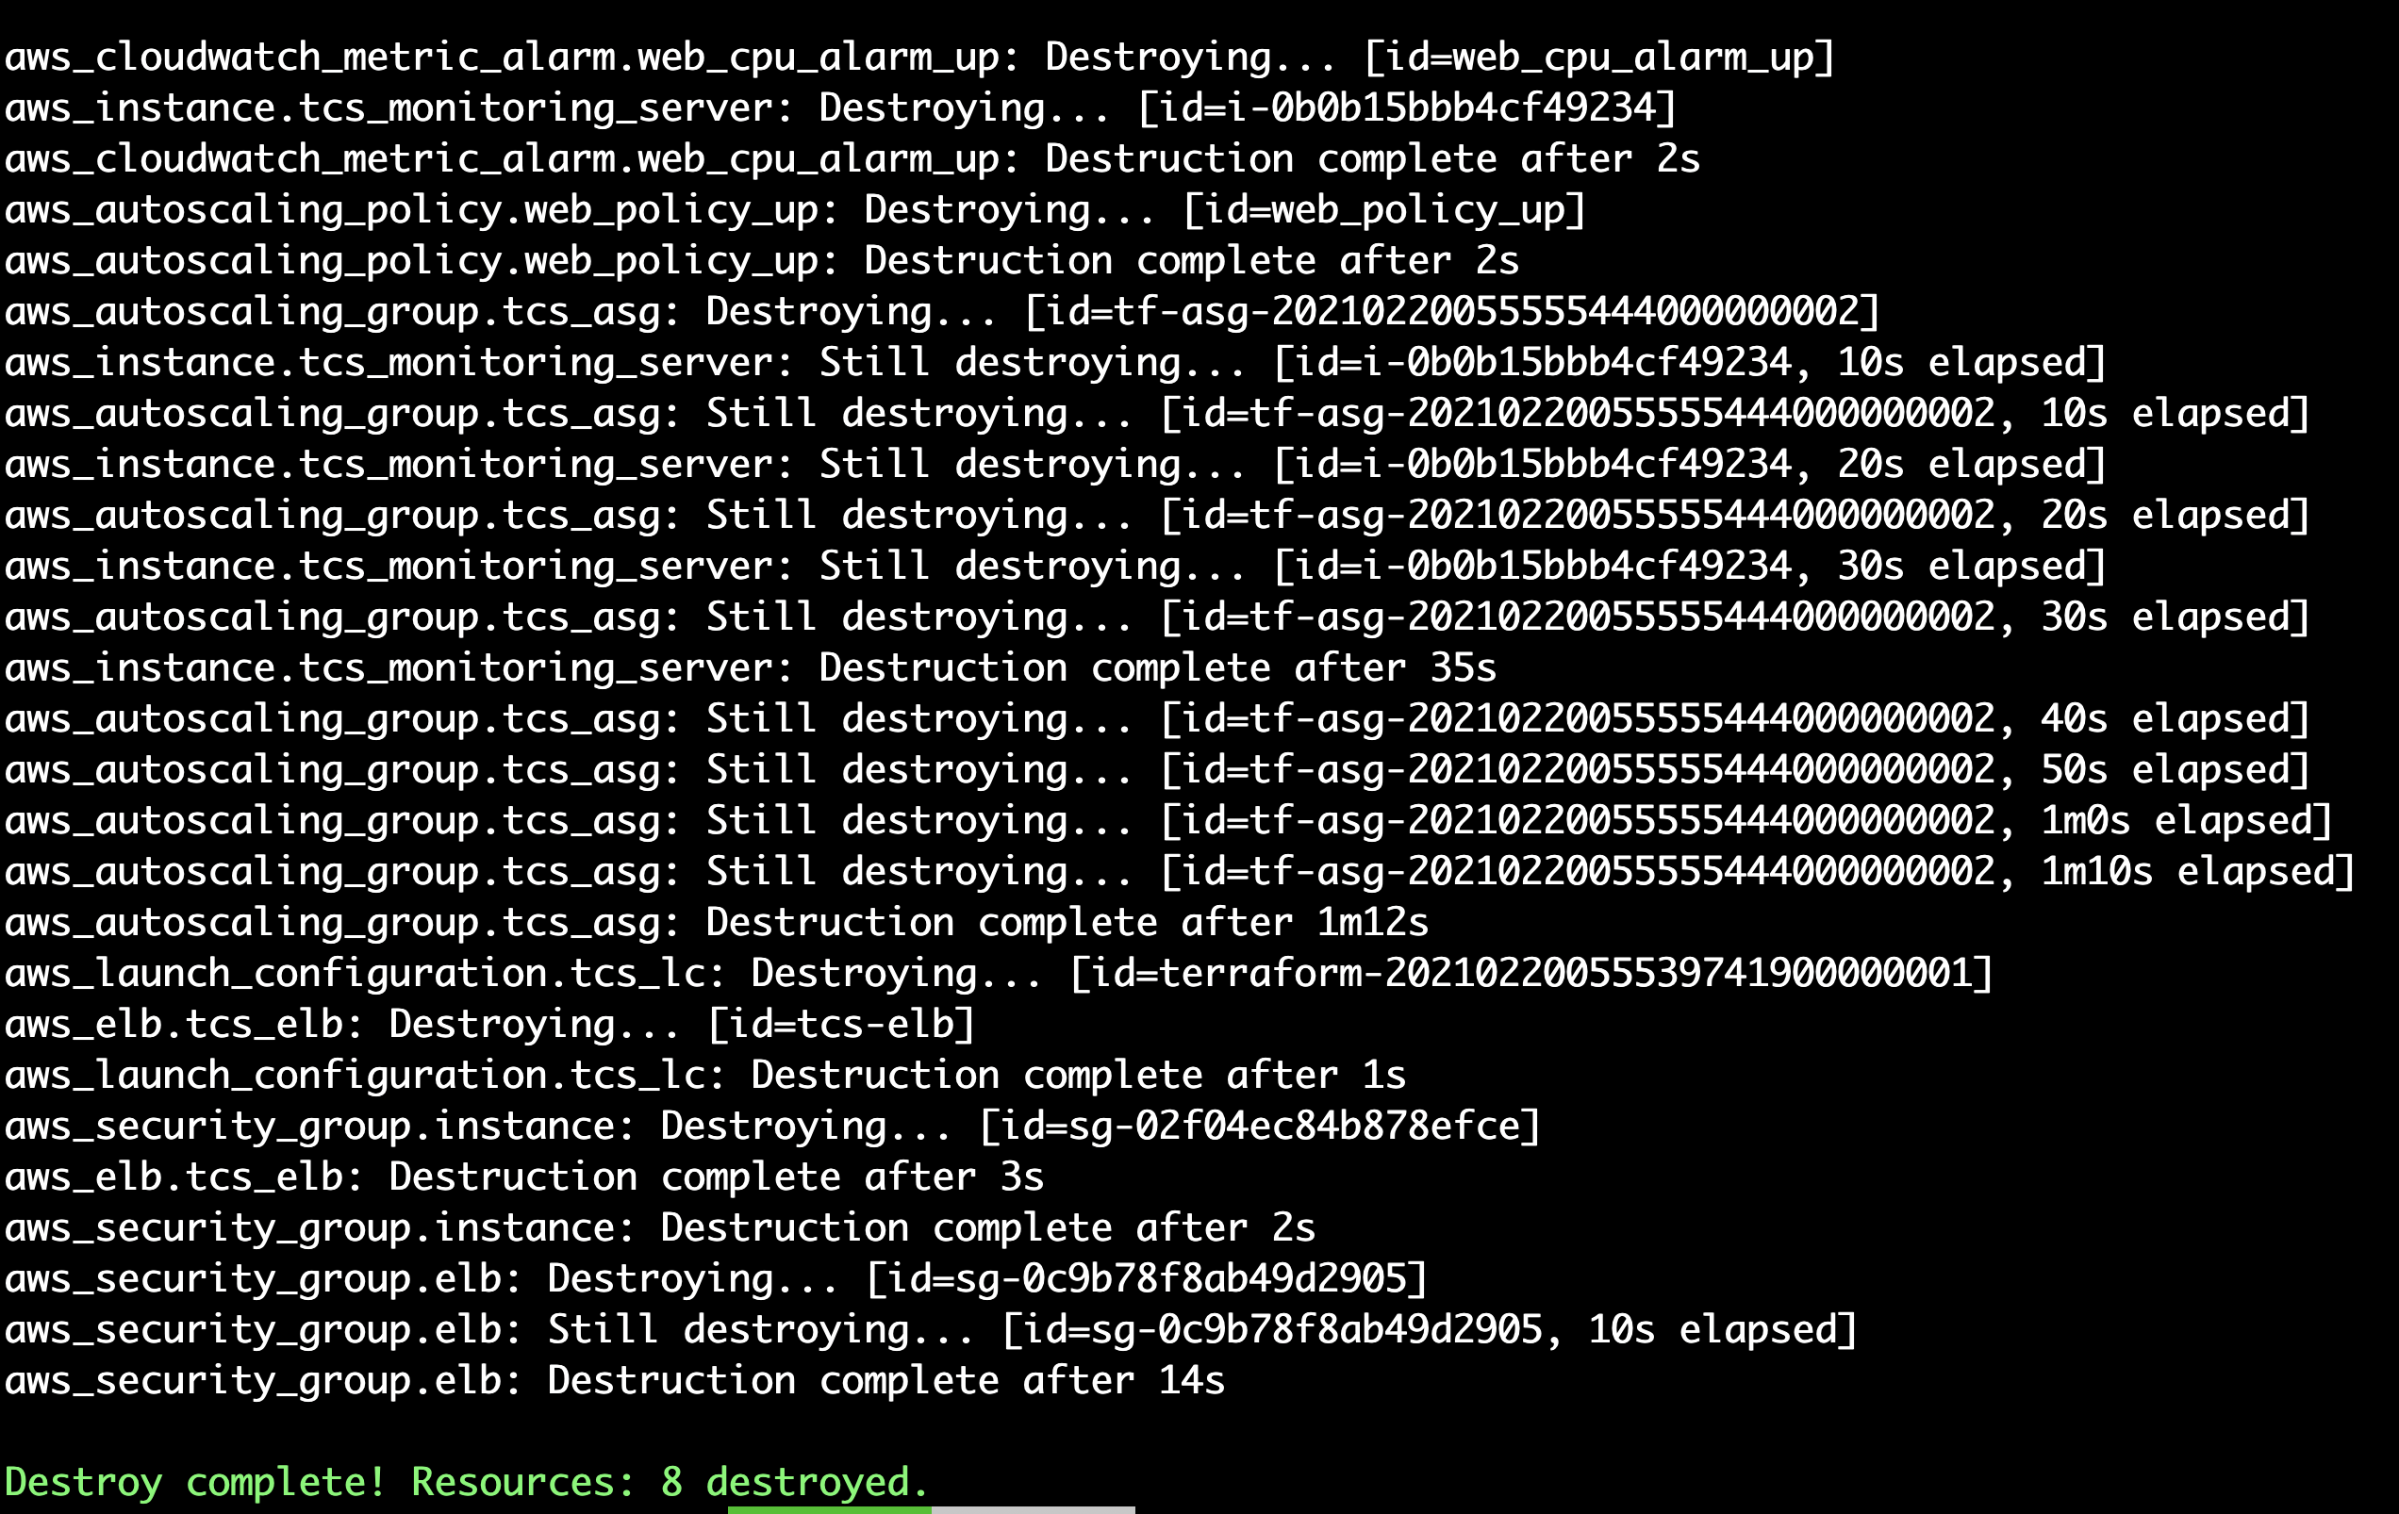
Decommissioning of Infrastructure

Slide 24
Benefits
Autonomous Infrastructure helps to reduce the manual intervention and also minimize human error.
An Autonomous Infrastructure can help organizations minimize that spend and boost service assurance, resulting in broad business benefits.
Maintenance free and less error prone.
Lower costs
Better reliability
Faster delivery
Improve time to market

Slide 25


